Slide 1

Vacation Home Rental
IS 620 - Advanced Database projects
Deliverable 3
Date 12/19/2017
Group 1 Members:
Abishek Agarwal Poddar
Balakumaran Bhoopathi
Mary Varsha Venantius
Neha Reddy Chandupatla
Siddhie Shah

Slide 2

Contents
Introduction
Code Management
ER Diagram
Demonstration
Questions and Answers

Slide 3
Introduction
Designed an Account management database for a Vacation Home rental which provides & manages User and host with facilities like listing home, amenities, available dates, booking and so on.
Implemented PL/SQL procedures for each set of required features and tested the database using sample data's.
Created Project Management Schedule and Resource allocation, Design document which included ER Diagrams and SQL statements to create tables and insert data.

Slide 4
Code Management
Techniques Used
a) Stored Functions and Procedures
b) Implicit and Explicit Cursors
c) Control Statements and Exception Handling
Programming Language
PL-SQL
Tools Used
Oracle SQL Developer

Slide 5
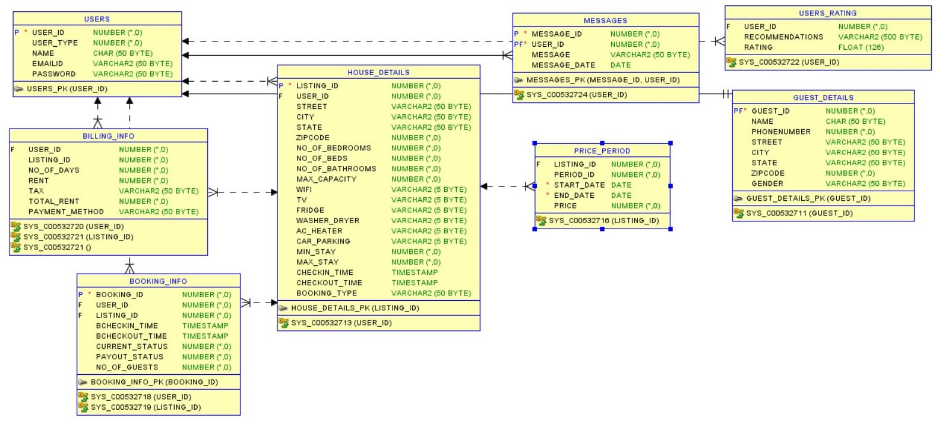
ER Diagram

Slide 6
Conclusion
8 tables
15 features
Demonstration

Slide 7
Demonstration

Slide 8
THANK YOU ALL FOR YOUR SUPPORT AND COOPERATION

